Slide 1
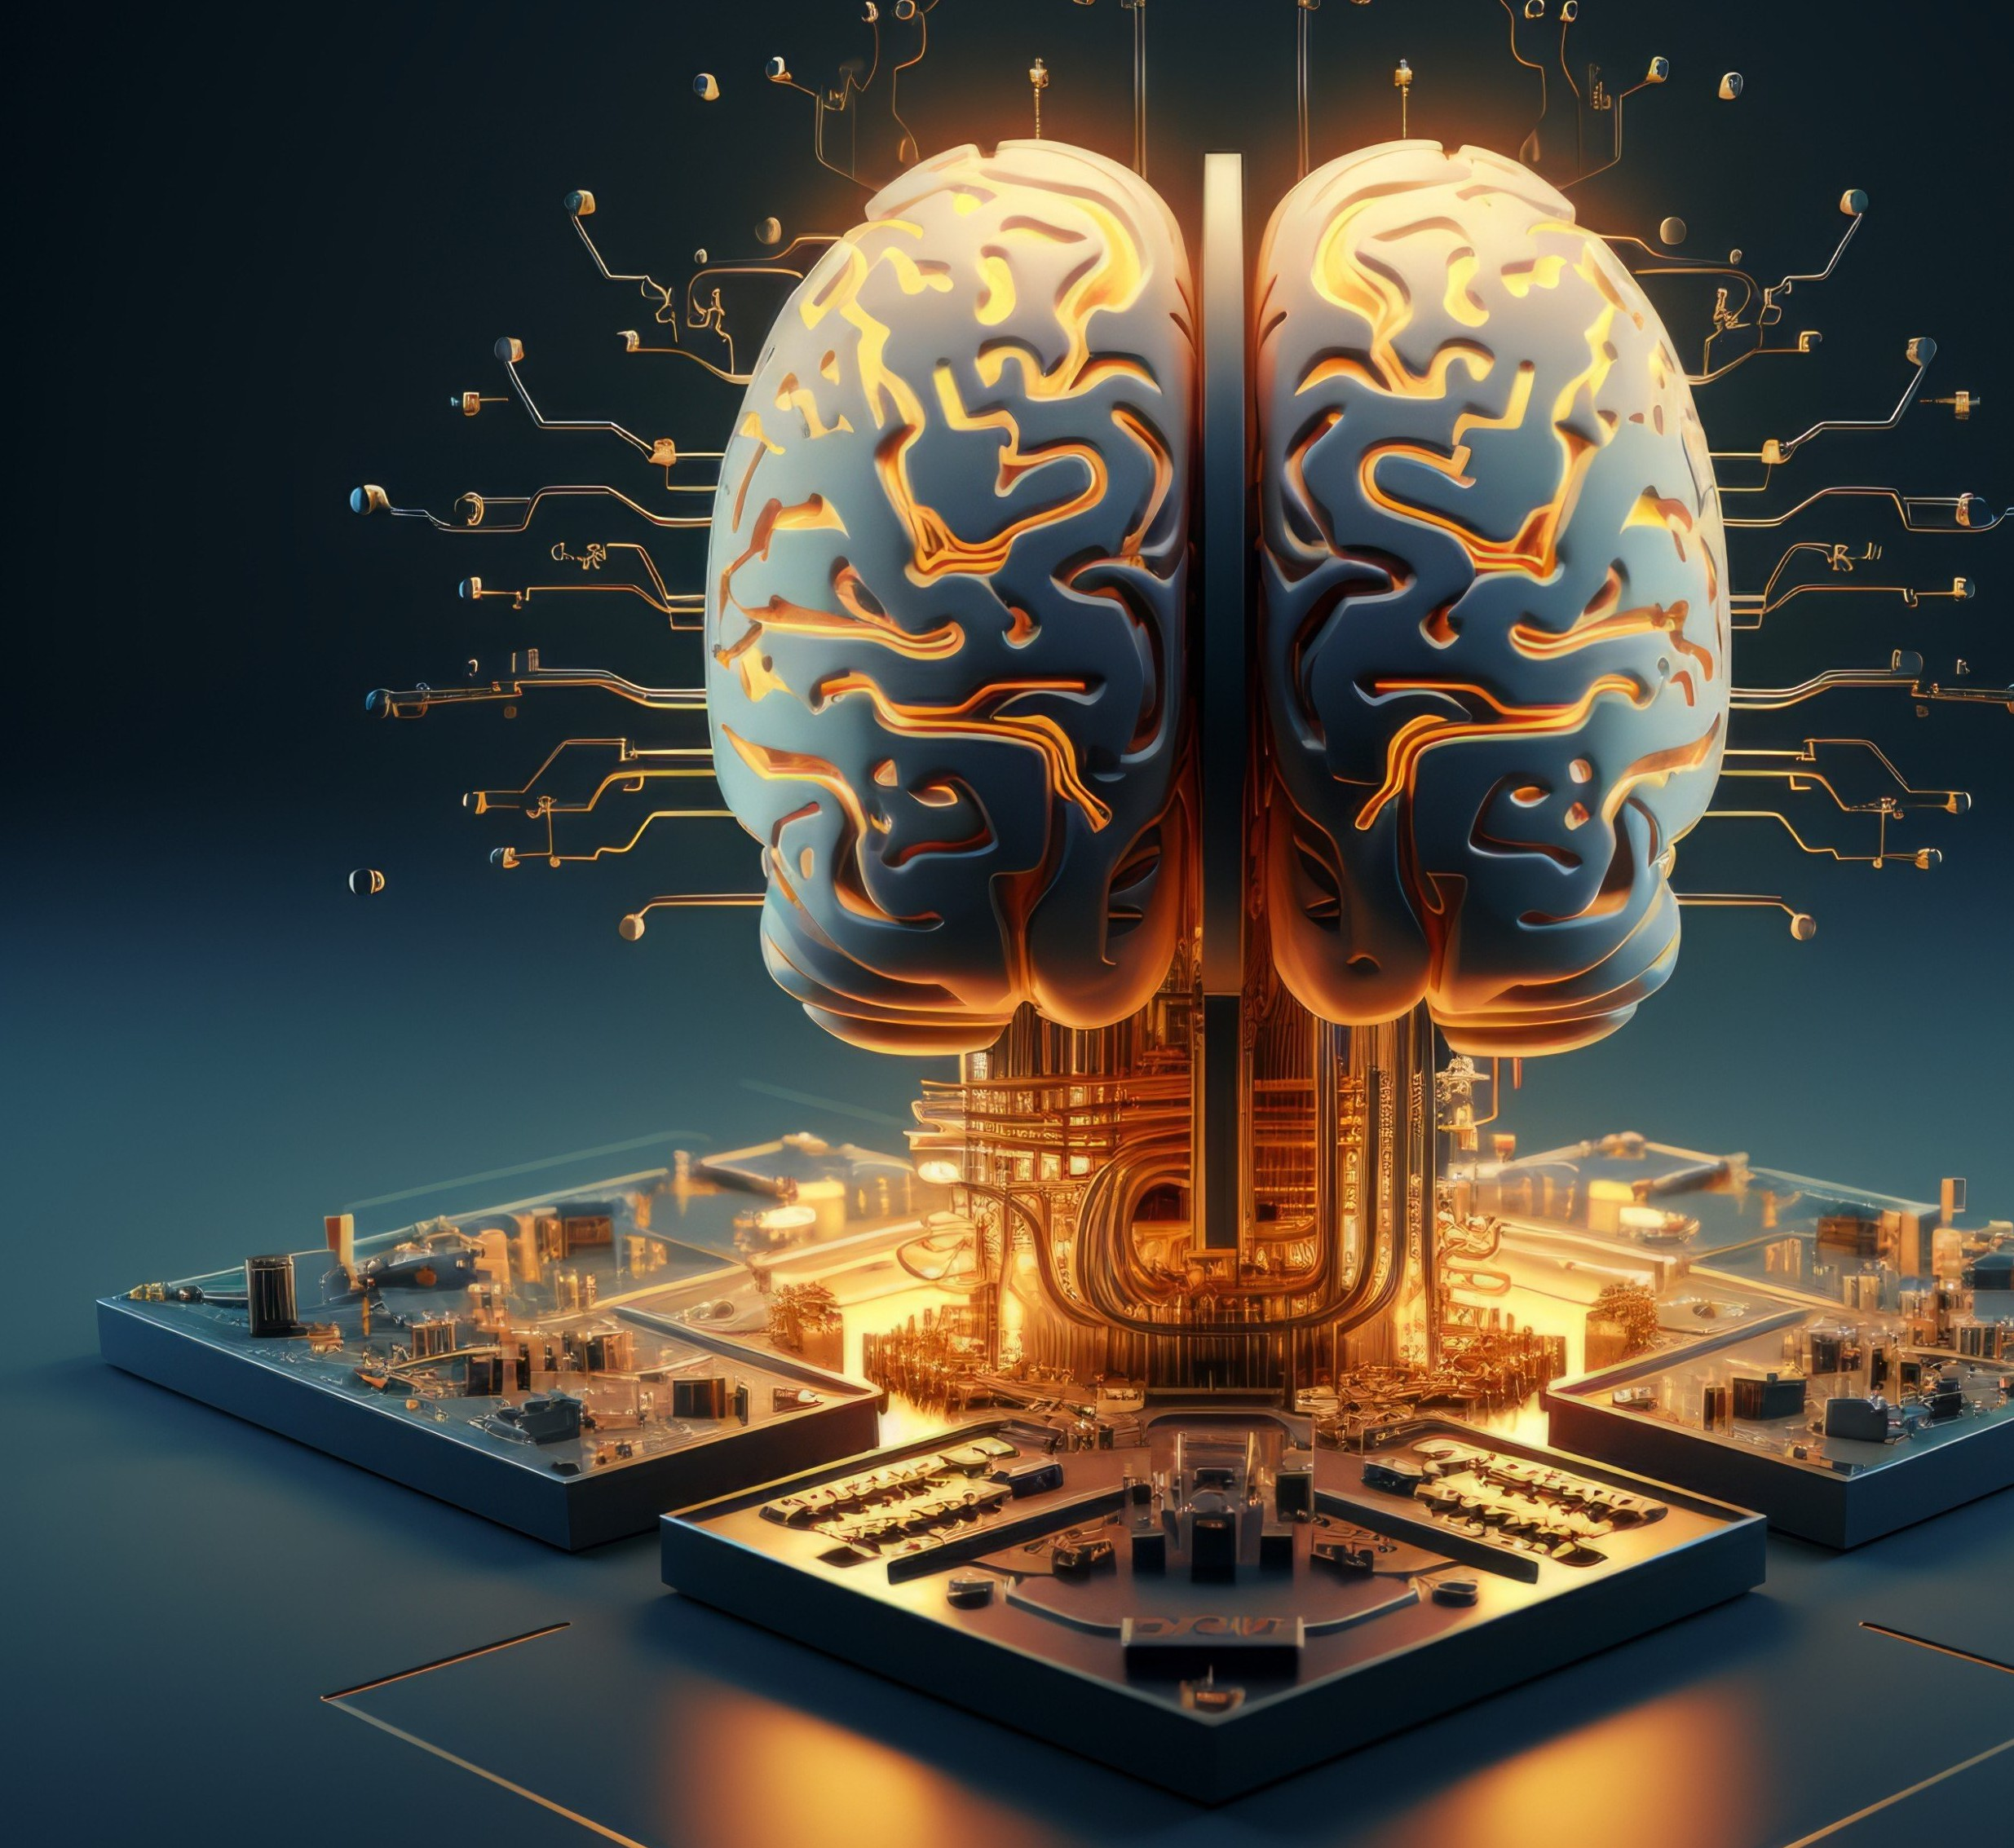

Major Project
Veronica
BY
Mahboob Hasan

Slide 2
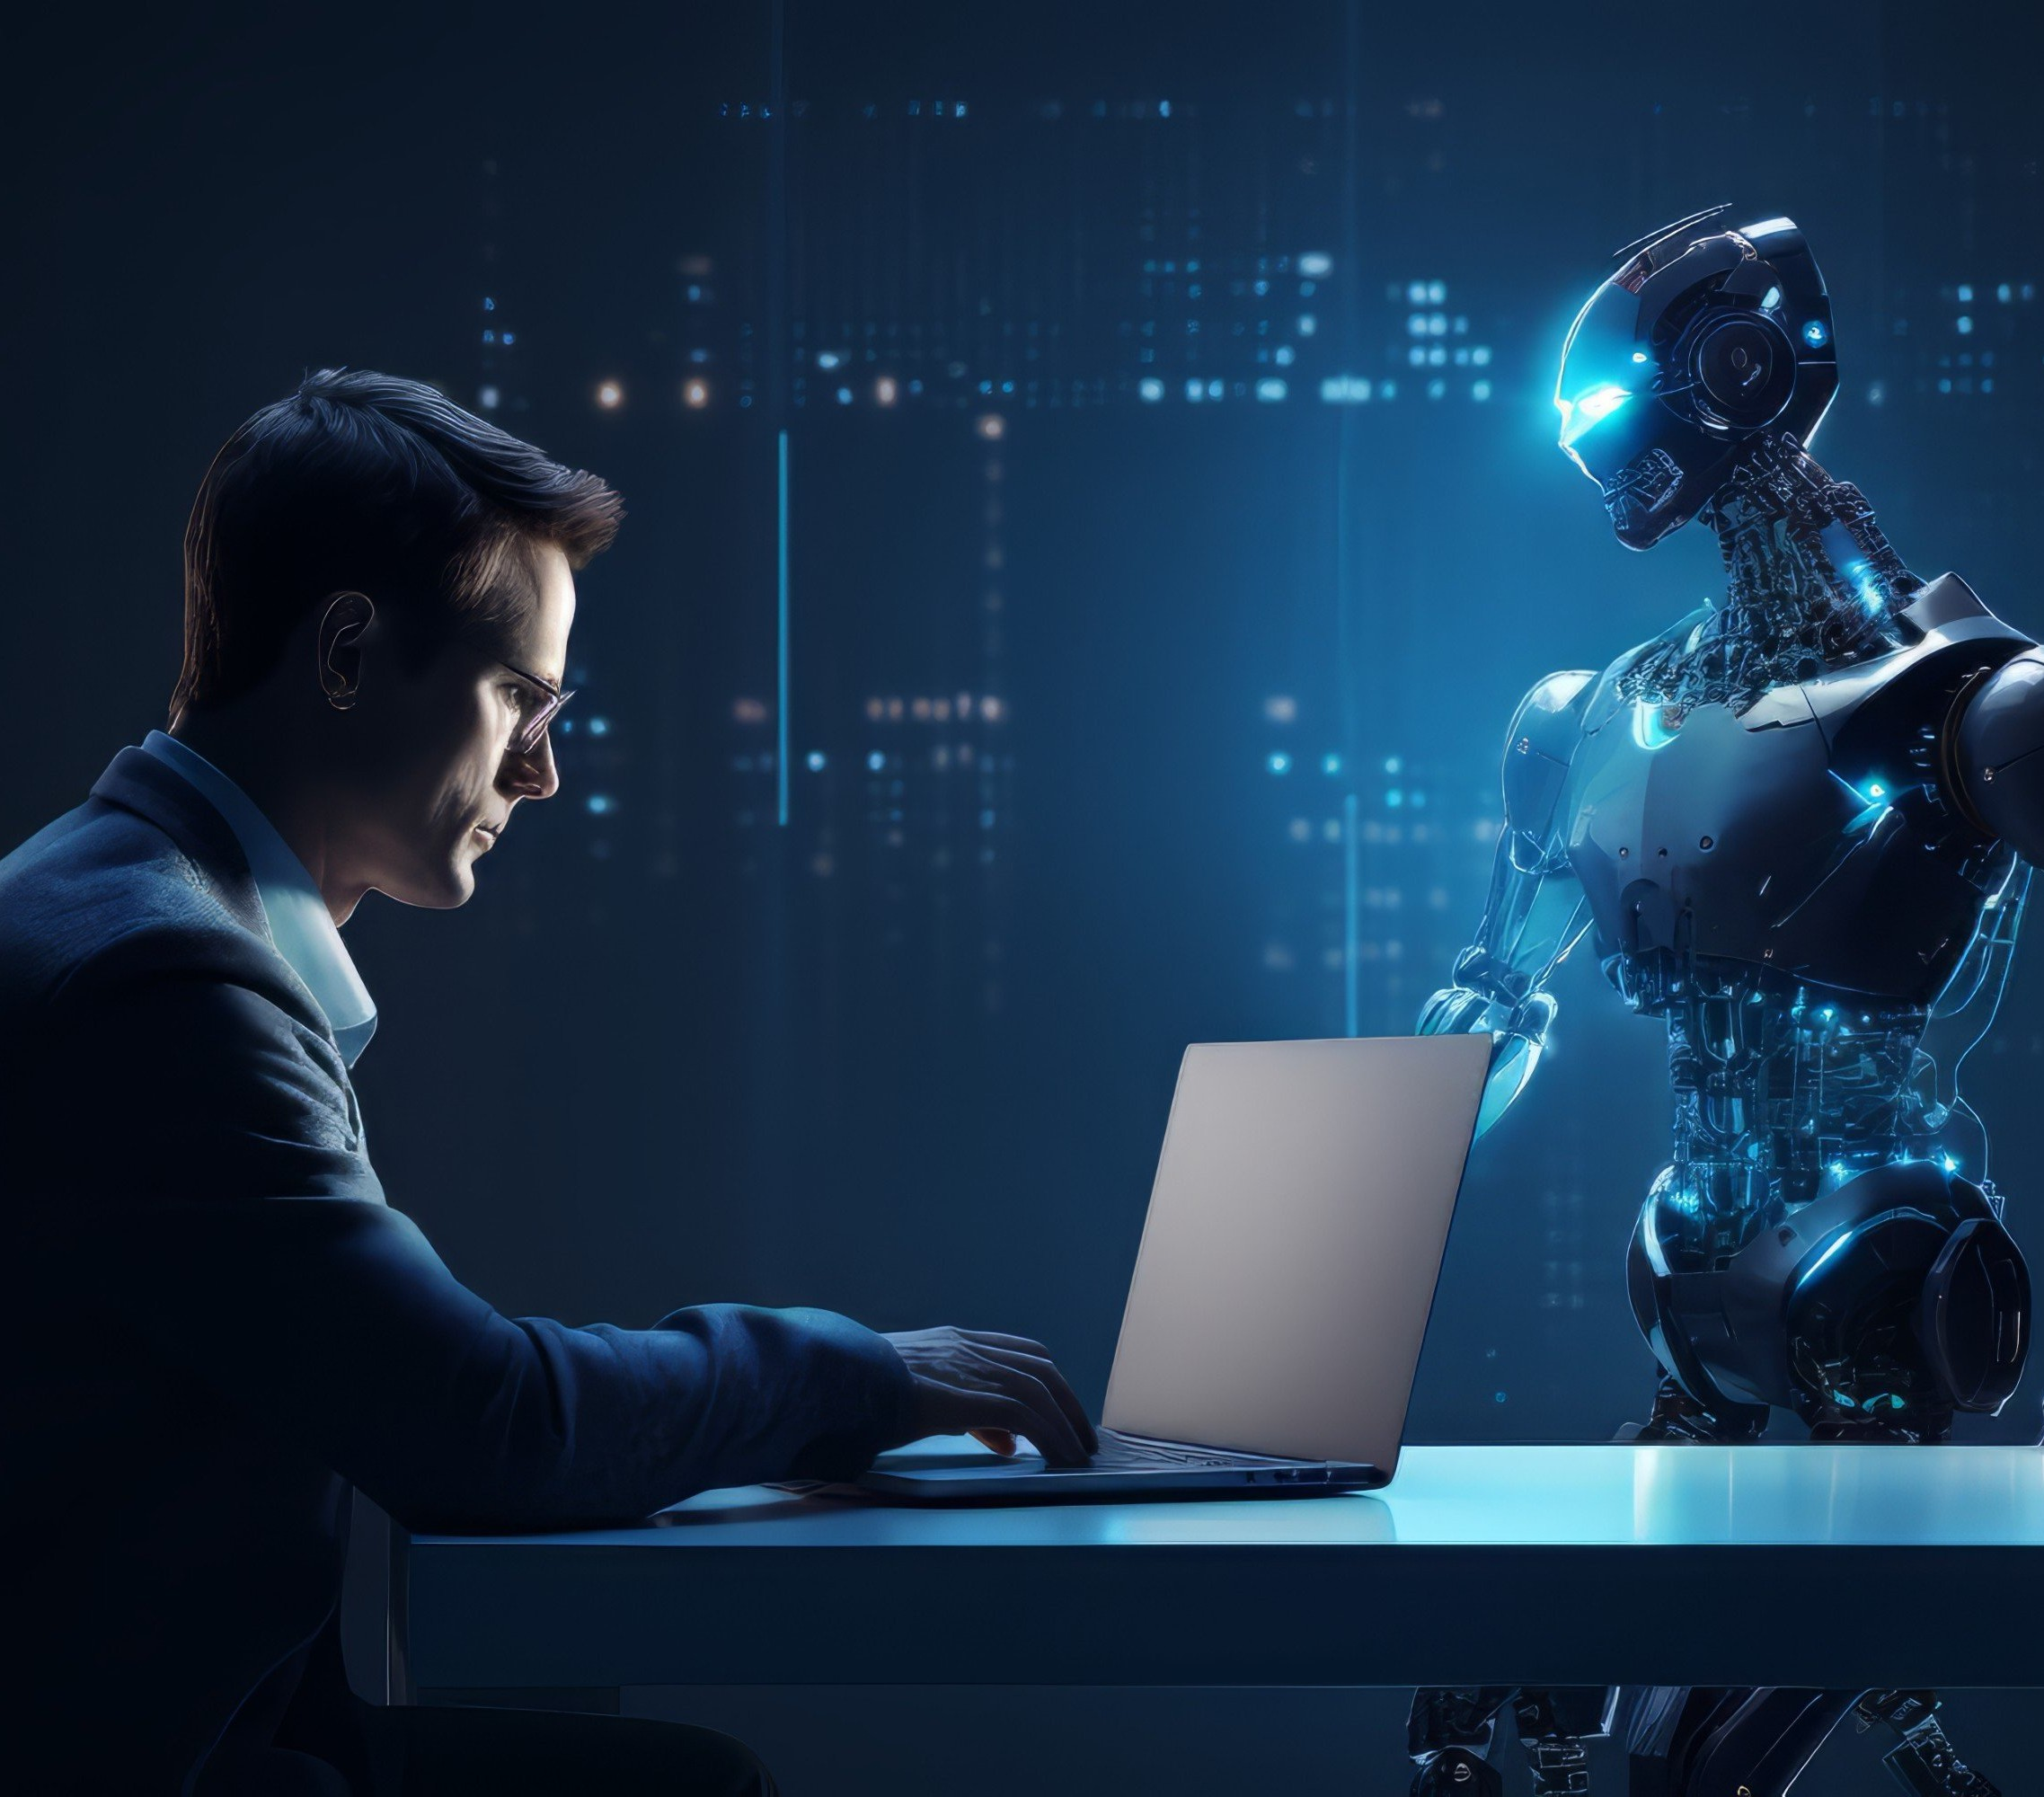
INTRODUCTION
An AI assistant is a virtual program designed to assist users in various tasks. It uses artificial intelligence to understand and respond to user queries. AI assistantscan provide information, perform tasks, and offer personalized recommendations. They are becoming increasingly popular in homes and businesses for their efficiency and convenience.

Slide 3

VERONICA's INSPIRATION
AI assistants provide inspiration by enhancing productivity, offering quick access to information, and streamlining tasks. Their ability to learn and adapt empowers users to achieve more e ciently. By automating repetitive processes, they free up time for creativity and innovation, sparking inspiration in various ﬁelds.

Slide 4
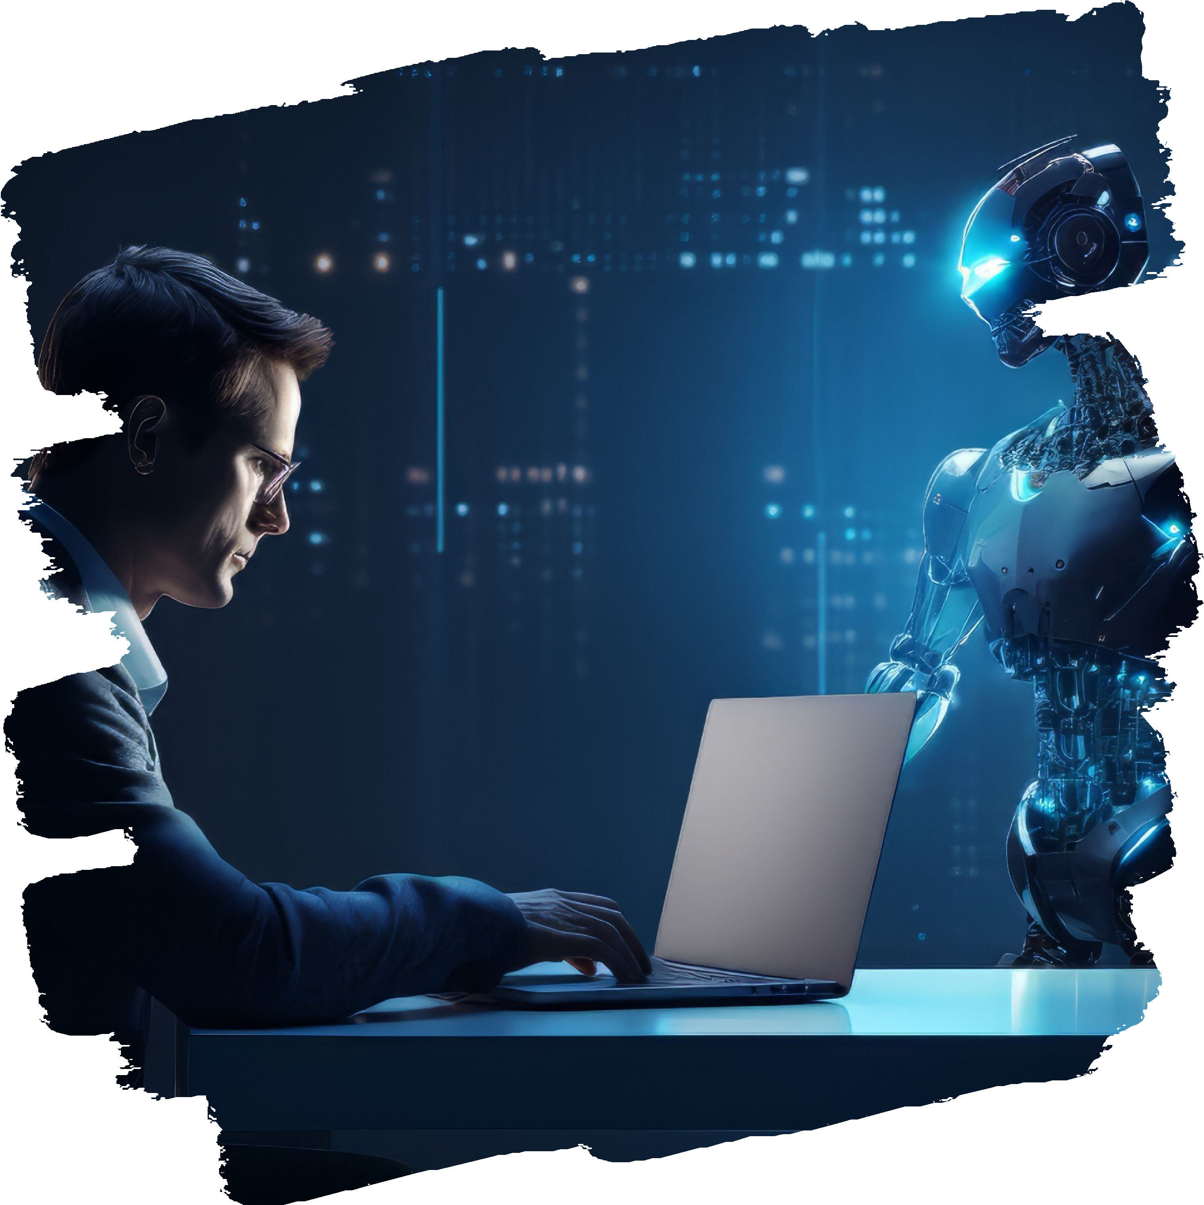
PURPOSE
AI assistants serve to streamline
tasks, increase
productivity, and access to
provide quick
information. They assist users in various activities, from scheduling appointments to answering queries. Their purpose is to enhance efficiency, save time, and improve user experience by offering personalized support and automating repetitive tasks.

Slide 5
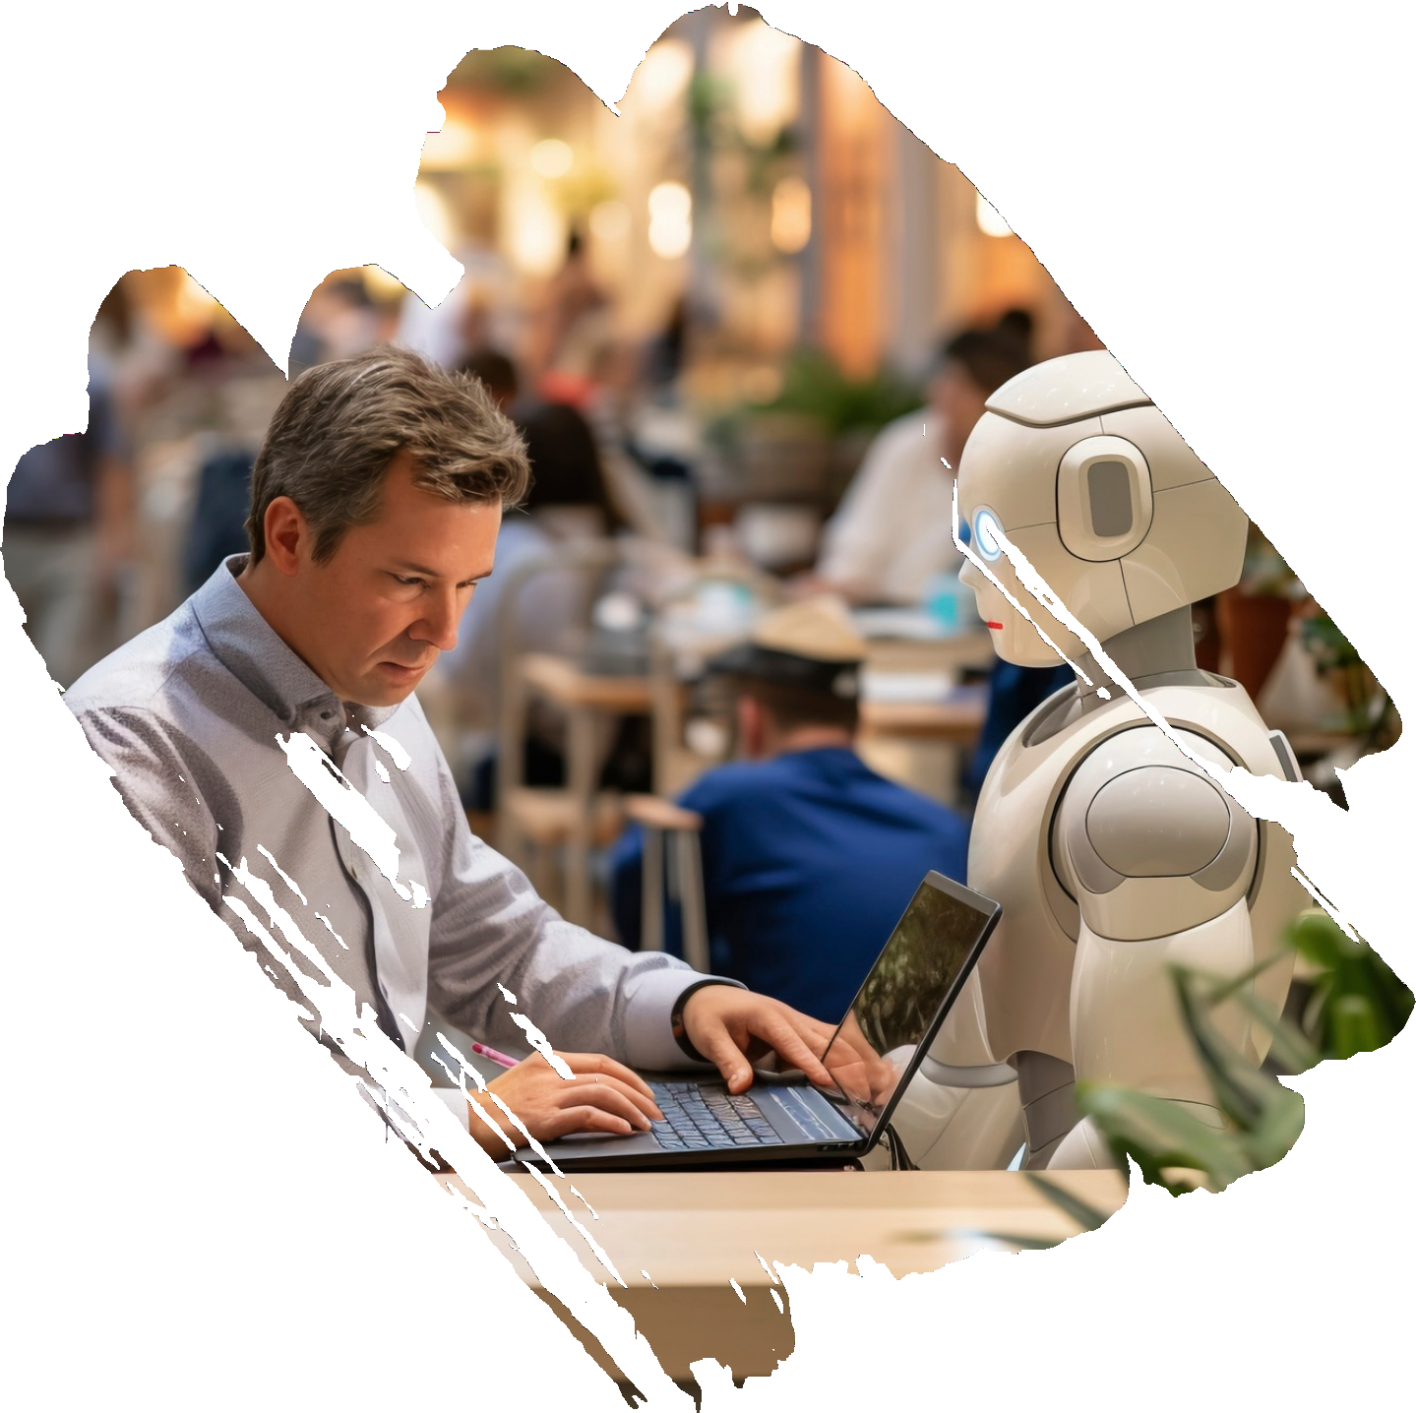
SCOPE
The scope of an AI
includes tasks like
assistant
data
analysis, scheduling, reminders, and research. It can help with information retrieval, language translation, and even content creation. AI assistants can streamline workﬂows, increase productivity, and provide personalized support to users in various industries.

Slide 6



FUNCTIONAL REQUIREMENTS
Natural Language Understanding (NLU)
Natural Language Generation (NLG)
Task Automation Personalization
Multimodal Interaction

Slide 7
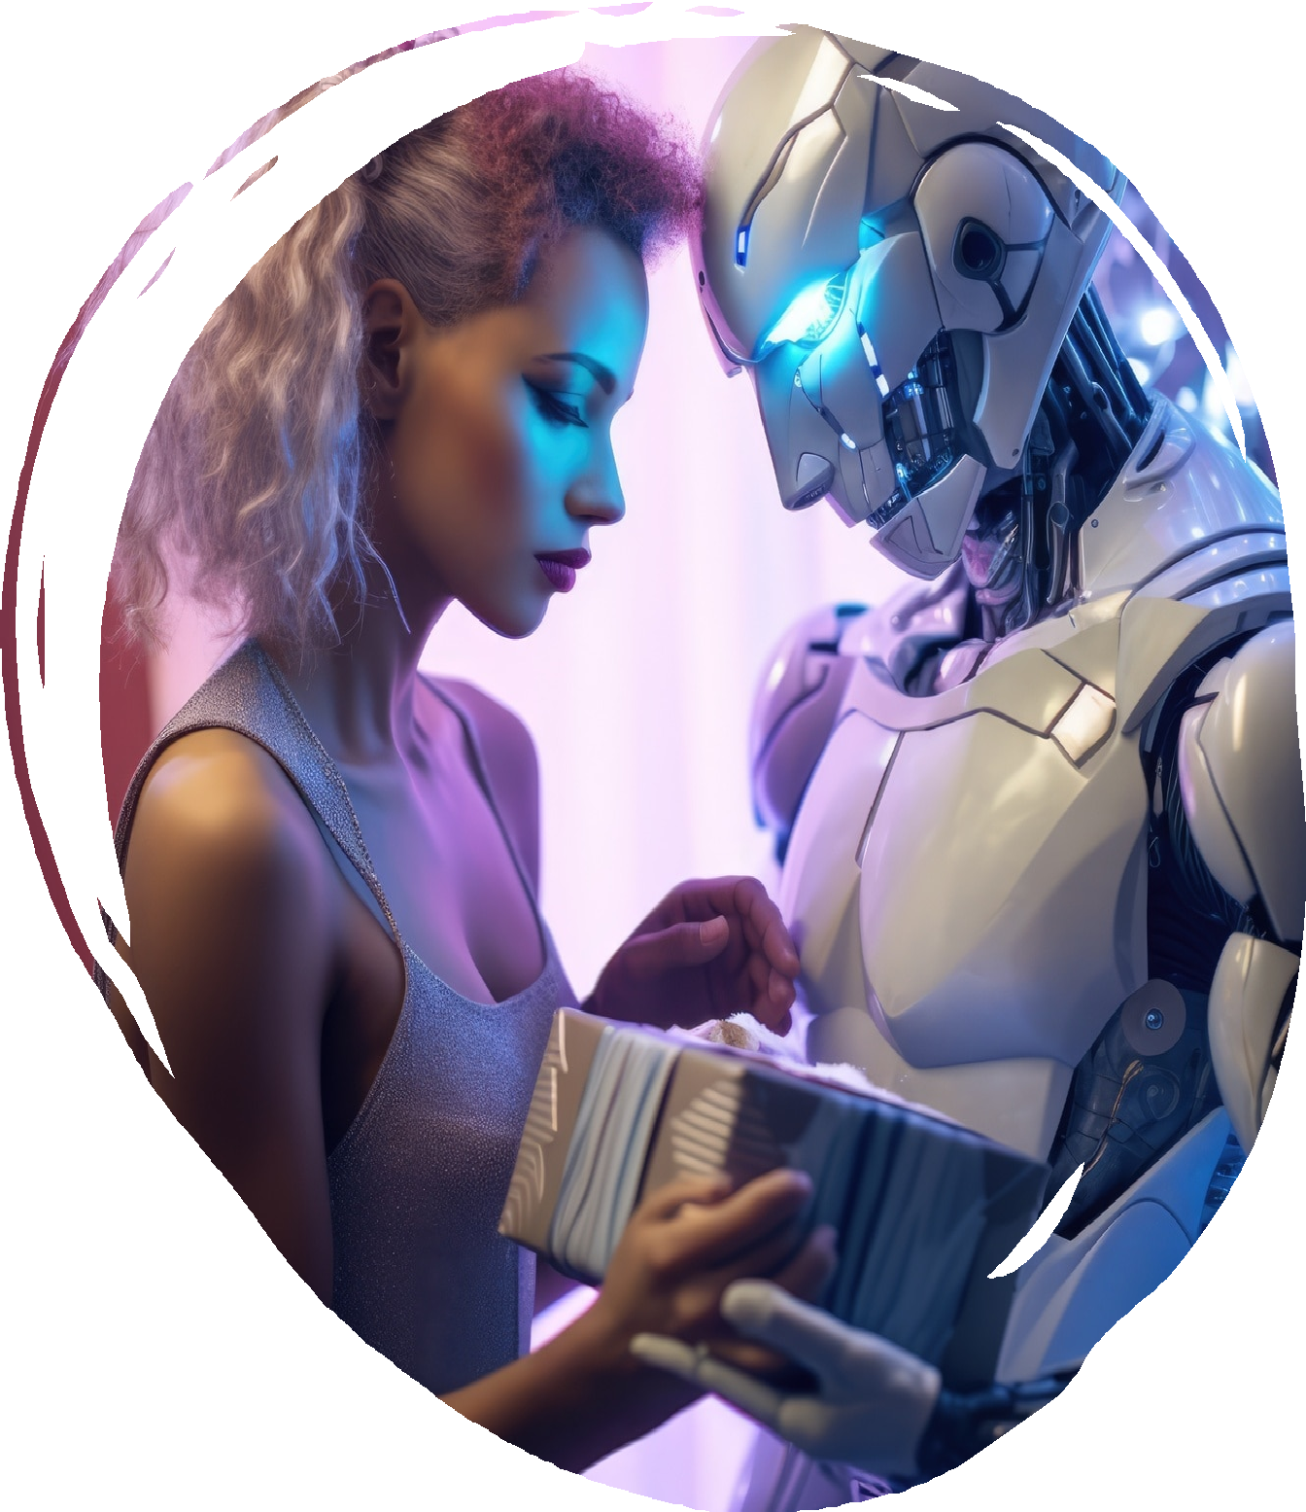

NON-FUNCTIONAL REQUIREMENTS
Usability Performance Reliability Documentation Testing Interoperability

Slide 8
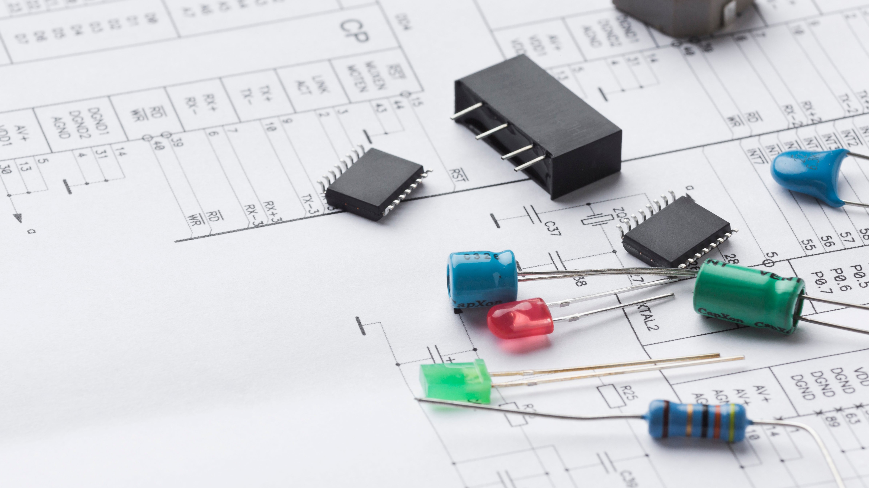
Hardware Requirements
Processor
Intel Pentium Intel core i3 Ryzen
RAM 2GB (Minimum)

Slide 9

Software Requirements
Operating System:
Windows 8/10/11 /Linux /MacOS
Web Browser:
Chrome/ Microsoft edge/Brave/Mozilla Firefox
Operating System:
Windows 8/10/11 /Linux /MacOS
Web Browser:
Chrome/ Microsoft edge/Brave/Mozilla Firefox
Web Designing:
MERN

Slide 10
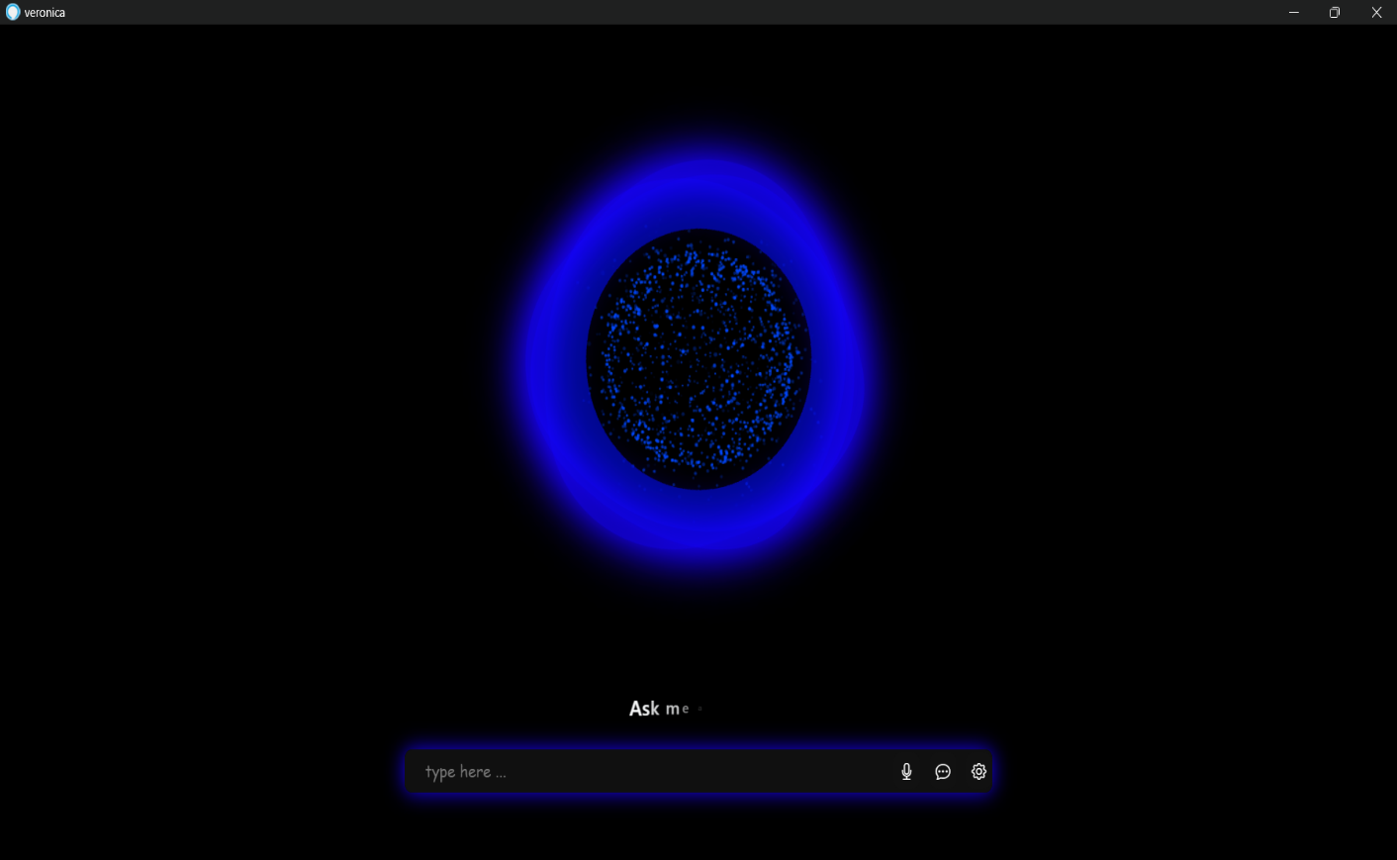
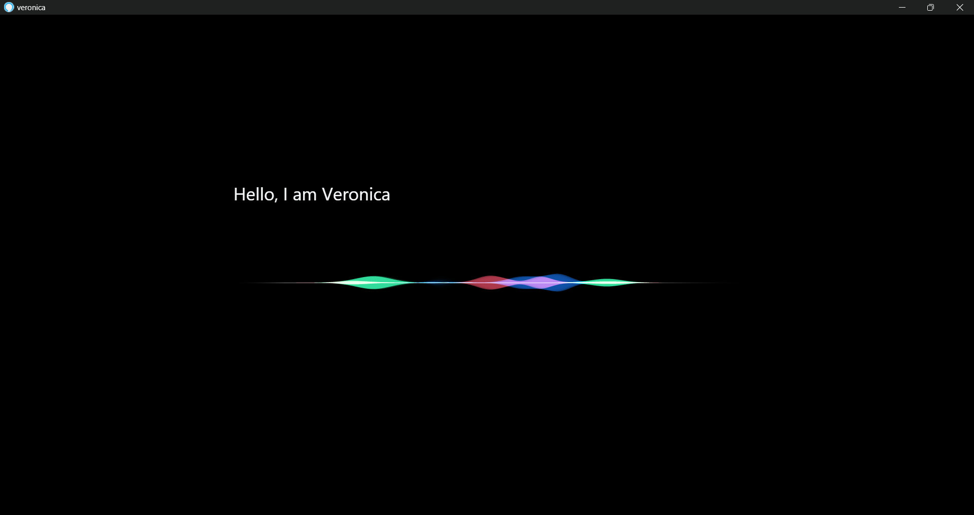
Project Preview

Slide 11
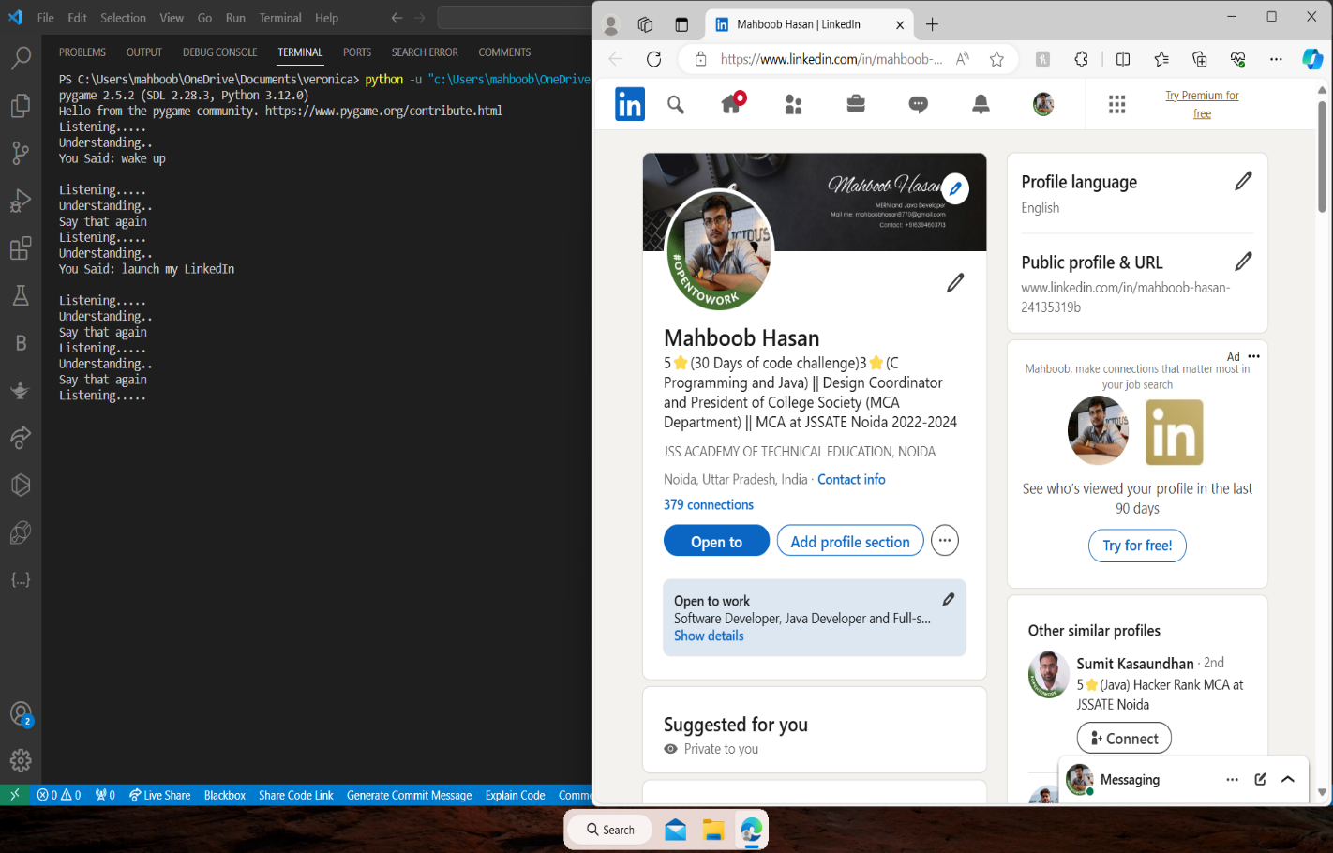
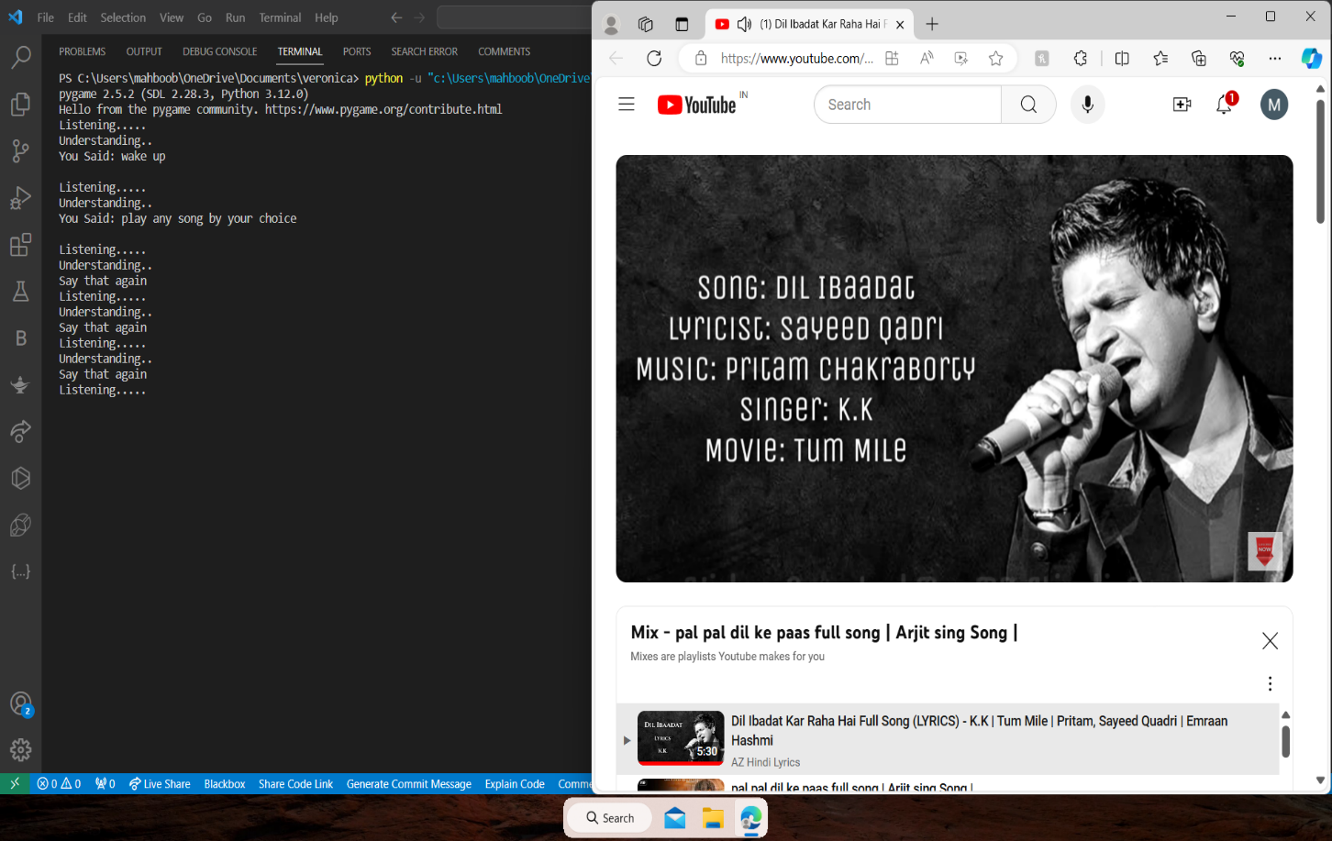
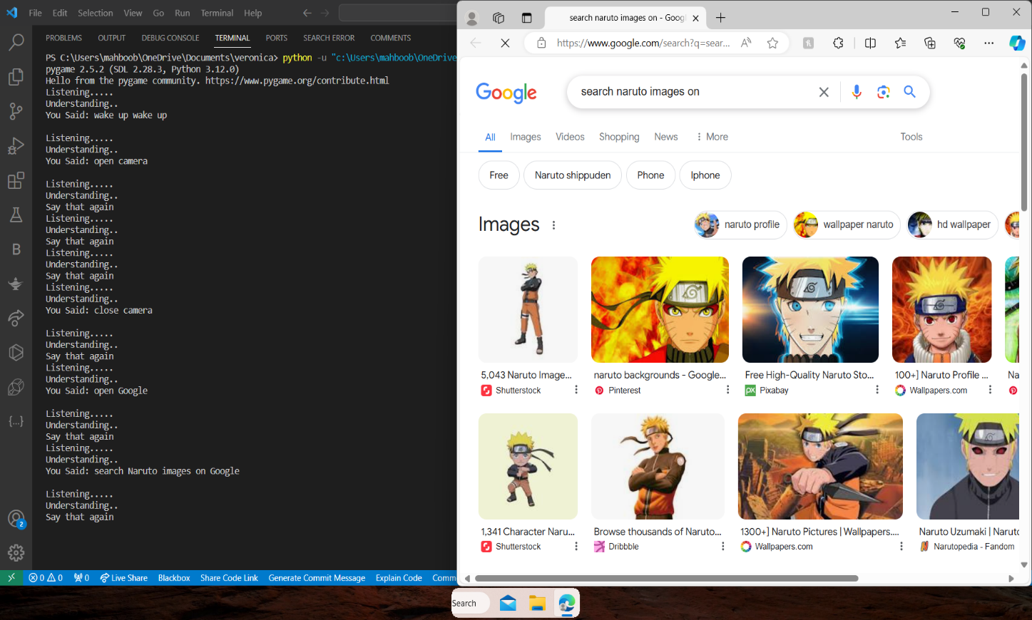

Slide 12
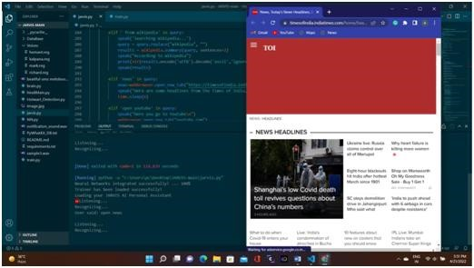
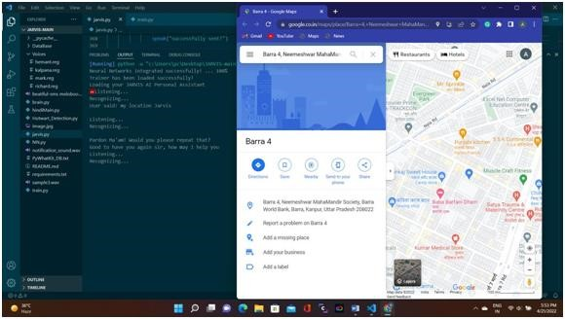
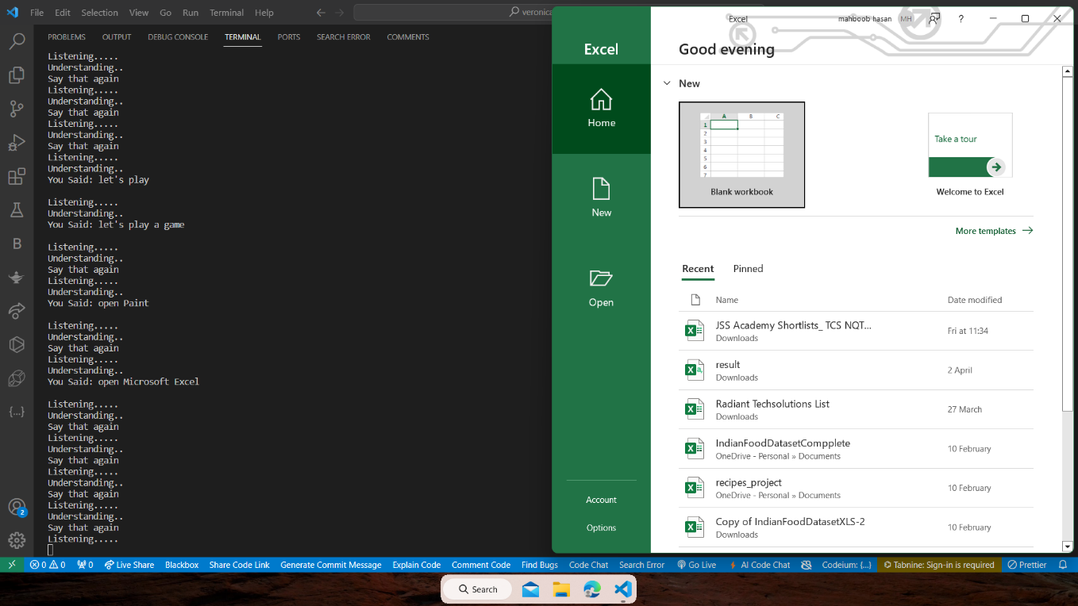

Slide 13
Conclusion
The future of AI assistants is brimming with promise, offering unparalleled efﬁciency and innovation. Embracing these advancements will undoubtedly propel industries and individuals into a new era of productivity and convenience.

Slide 14

